Slide 1
Taxonomic classification of ants (Formicidae) from images using deep learning
-- a proposal presentation --
Marijn JA Boer
marijn.boer@naturalis.nl
February 6th, 2018
Supervisor: dr. Rutger Vos

Slide 2
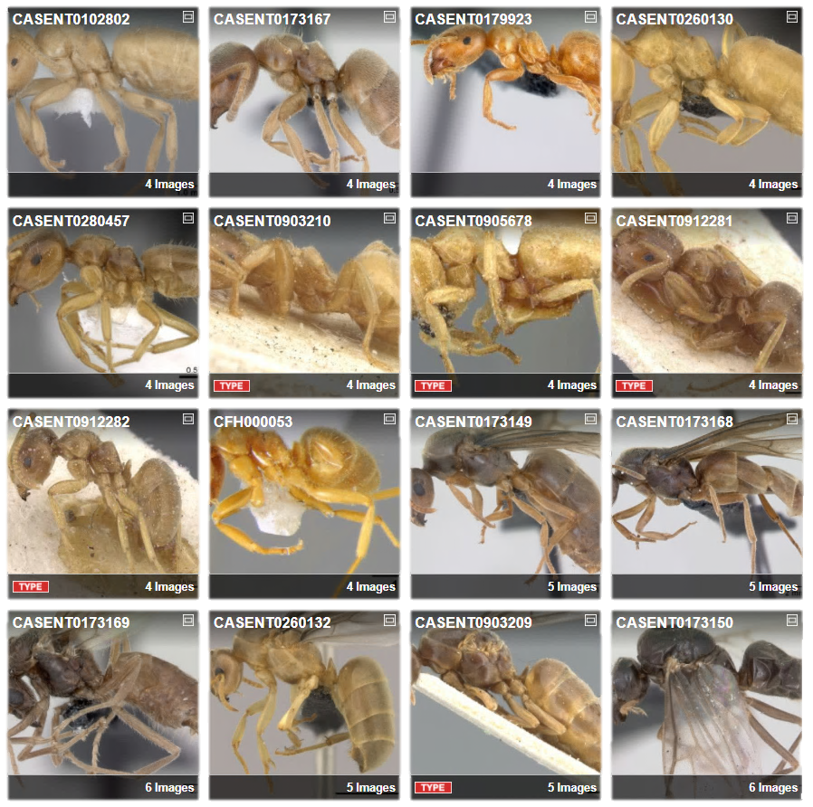
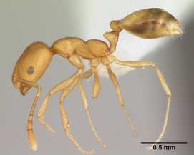
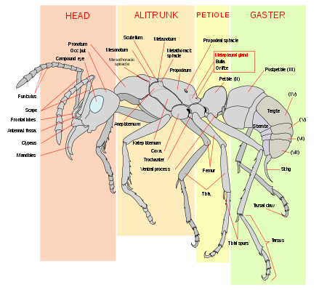
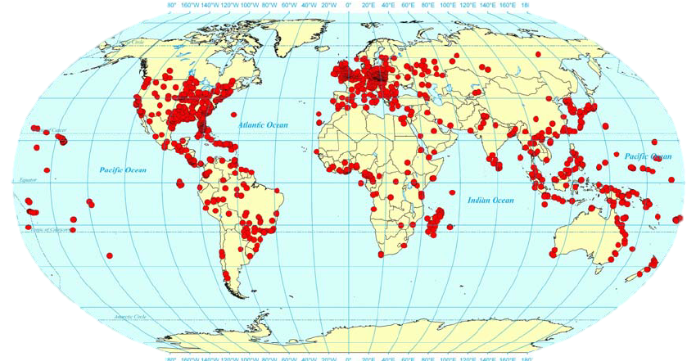
The ants
Global
Diverse
Identification
Monomorium pharaonis
AntWeb. Available from: https://www.antweb.org/images.do?rank=species&name=flavus&genus=lasius. Accessed 31 January 2018
Wetterer JK. Myrmecological News 13, 115–129 (2010
Photo by April Nobile / From www.antweb.org. Accessed 31 January 2018
Source: https://en.wikipedia.org/wiki/Ant

Slide 3
Important to know the species
Insight
Conservation
Ecosystems
Biodiversity
Notes:
Ecosystem services:
pest control on crops (Bisseleua et al. 2017)
Nutrient provision, water storage/regulation, maintenance of soil structure, climate regulation survice, soild diviserity (Catalina et al. 2014)
Biodiversity:
Island species curve
Richness surrogate

Slide 4
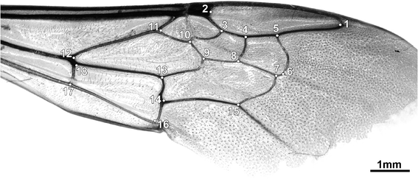

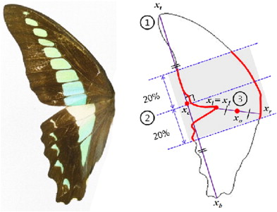
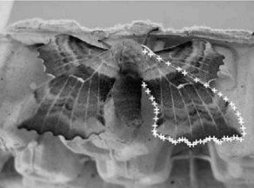
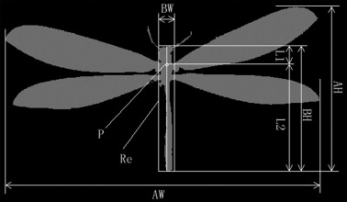
Computer vision
Machine learning
Learns on introduced features
Gerard, M. et al. Apidologie 46, 644–653 (2015)
Watson, A. T. et al. Syst. Biodivers. 1, 287–300 (2004)
Kumar, N. et al. in Computer Vision – ECCV 2012 502–516 (2012)
Kang, S.-H. et al. J. Asia. Pac. Entomol. 15, 431–435 (2012)
Wang, J. et al. Knowledge-Based Syst. 33, 102–110 (2012)

Slide 5
https://blogs.nvidia.com/blog/2016/06/29/deep-learning-6/

Slide 6
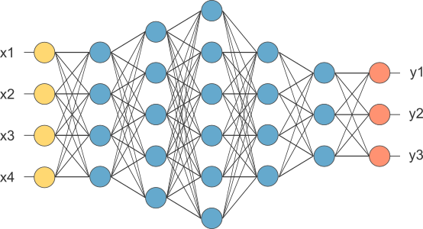
Deep learning
More promising
Higher accuracy
Feature learning
http://www.opennn.net/images/dep_neural_network.png
Notes:
Landmark input and species as output

Slide 7
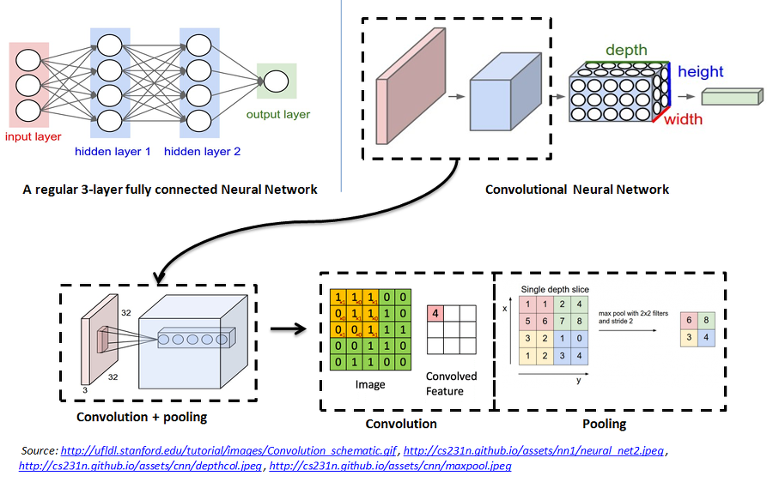
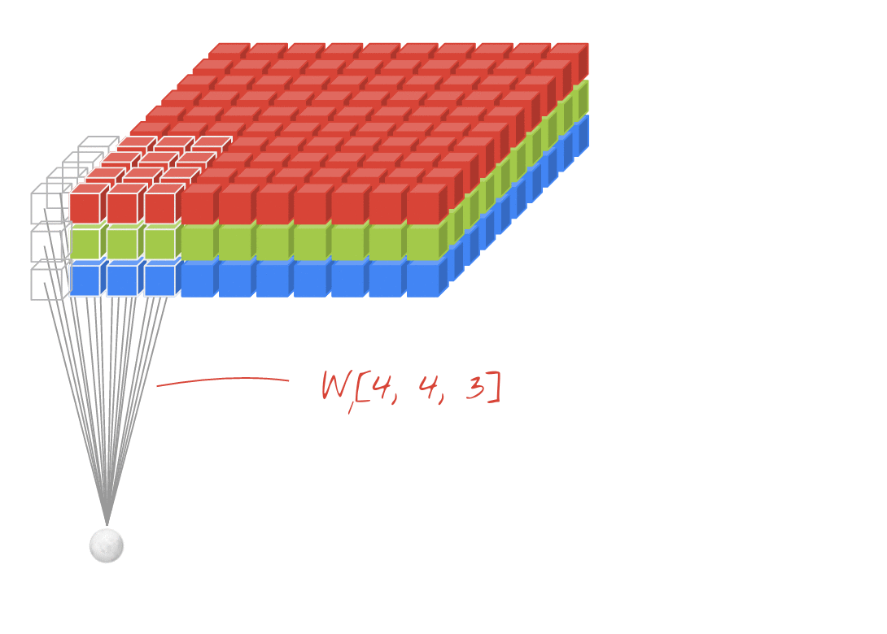
Convolutional neural network
1 | 0 | 1
0 | 1 | 0
1 | 0 | 1
https://codelabs.developers.google.com/codelabs/cloud-tensorflow-mnist/#10
https://github.com/Kulbear/deep-learning-nano-foundation/wiki/ReLU-and-Softmax-Activation-Functions

Slide 8
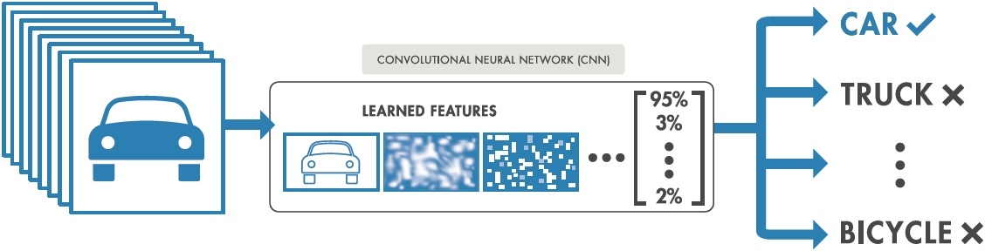
Convolutional neural network
https://nl.mathworks.com/content/mathworks/nl/en/discovery/convolutional-neural-network/_jcr_content/mainParsys/image.adapt.full.high.jpg/1508999492829.jpg

Slide 9
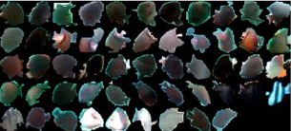
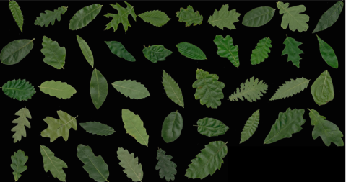
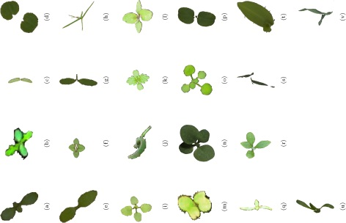
DL examples
Deep-Fish: 98.64%
Qin, H. et al. Neurocomputing 187, 49-58 (2016)
Deepplant: 99.5%
Lee, S. H. et al. 2015 arXiv:1056.08425v1
Weed/crops: 86.2%
Dyrmann, M. et al. Biosyst. Eng. 151, 72-80 (2016)

Slide 10

FormicID
Starting project…
https://github.com/naturalis/FormicID
Project is set up.
Notes:
So, a new project was started…

Slide 11
Project aim
Explore the possibilities on automatic insect identification using DL.
Naturalis’ goal of initializing an image classification system for own use.
In order to also explore the CNN-field a trial will be started to incorporate a "three type view per specimen" approach.

Slide 12
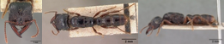
Questions
“Can ant species be discriminated from images using deep learning?”
Will three shot types classify species more accurately than a single shot view?
Which shot type will classify species more accurately?
Which image quality has the best accuracy vs training speed?

Slide 13
Approach
Creating a dataset
Neural Network training
Neural network testing

Slide 14
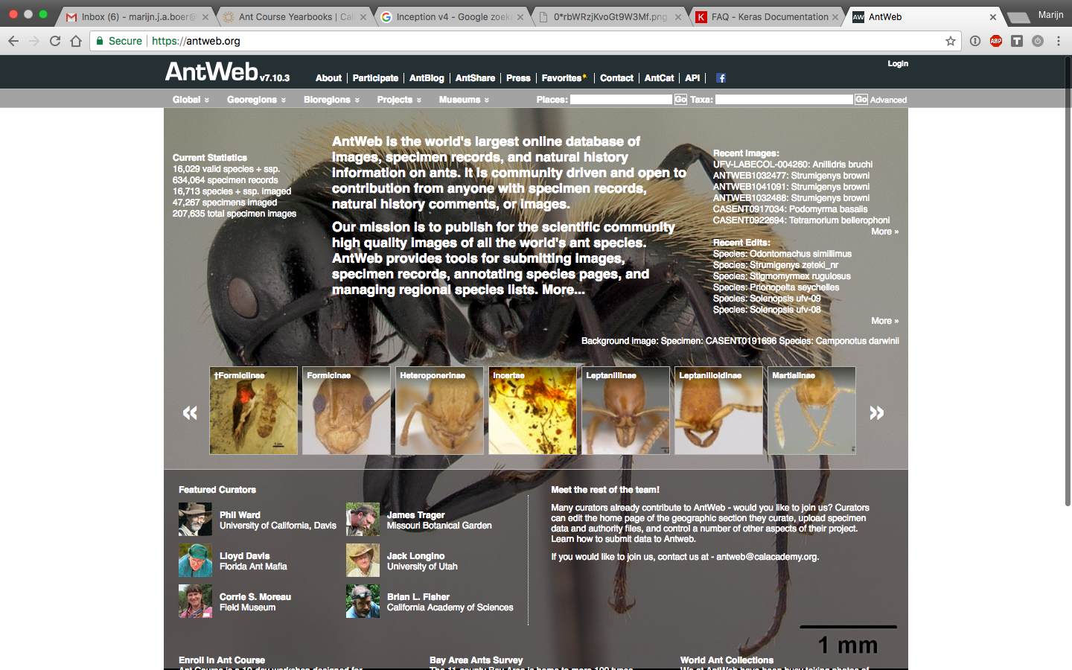

Slide 15
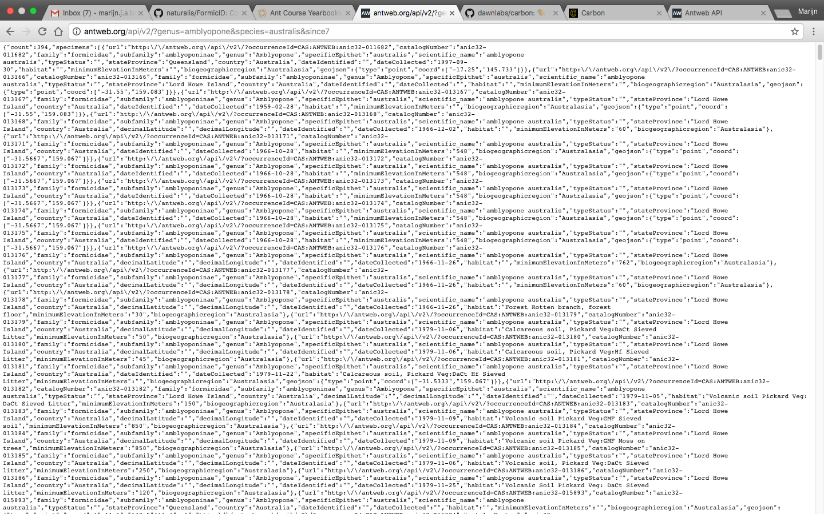
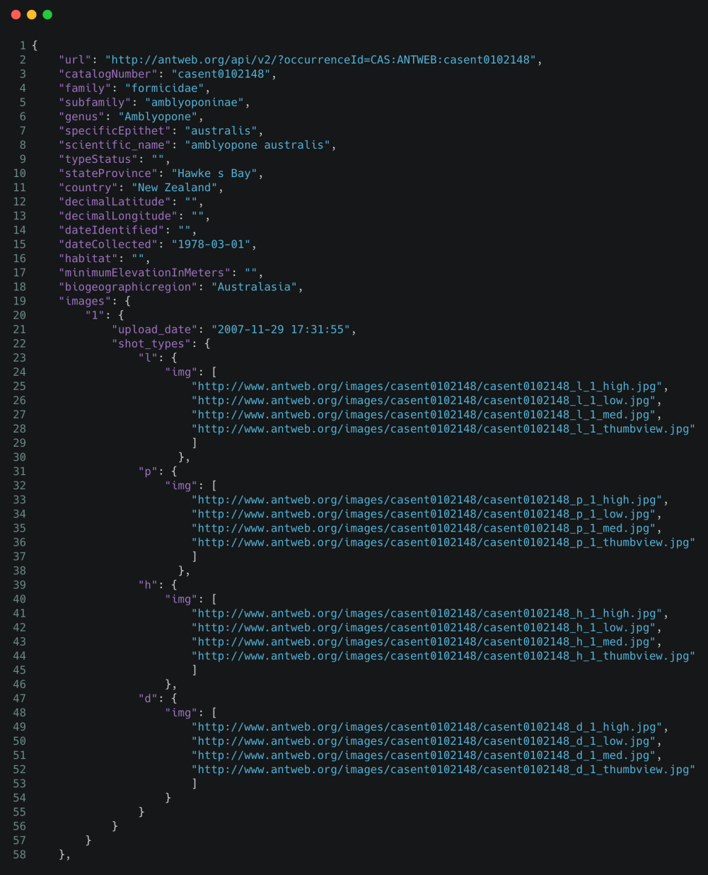
AntWeb

Slide 16
FormicID-97
97 species
Minimum of 68 images
3,441 specimens
10,204 images
Dataset
Test set
Test set
Training set
Validation set
Training set

Slide 17
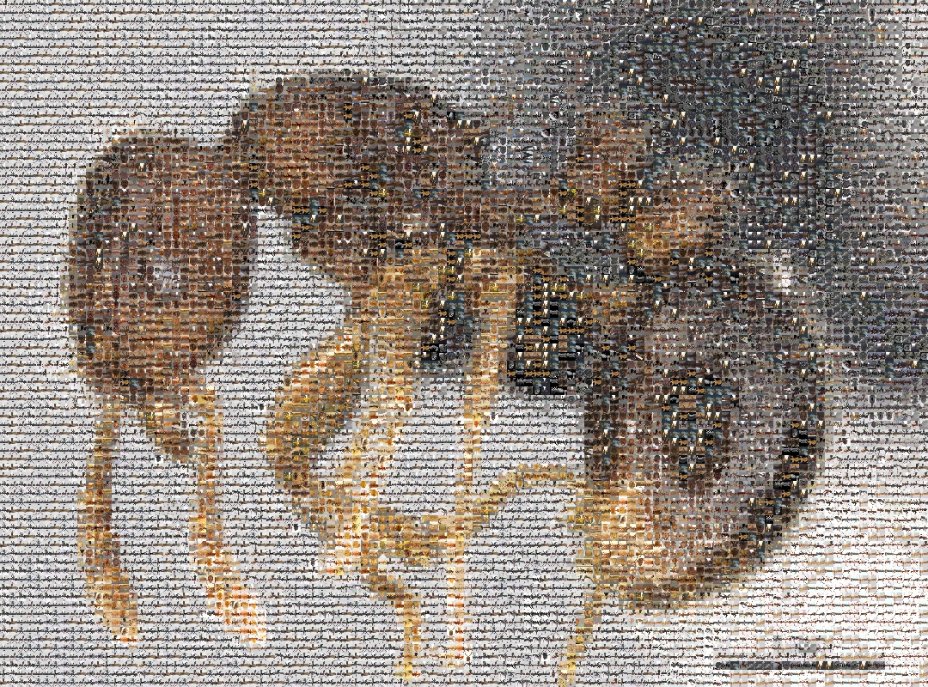
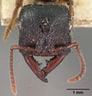

Slide 18
Species distribution

Slide 19
Shot type distribution

Slide 20
Image dimensions

Slide 21
File size

Slide 22
Network architecture
Potential NNs
Designing a NN
ResNet
He, K.et al. 2016 arXiv:1603.05027
Inception v.4
Szegedy, C.et al 2016 arXiv:1602.07261
Xception
Chollet, F. 2017 arXiv 1610.02357
DenseNet
Huang, G.et al. 2016 arXiv 1603.09382v3
Python
Keras
https://github.com/fchollet/keras
Algorithms
Dropout
Srivastava, N.et al. Journal of Machine Learning Research15, 1929–1958 (2014)
NADAM
Dozat, T. ICLR Workshop (2016)
Batch Normalization
Ioffe, S.et al. 2015 arXiv:1502.03167v3
http://joelouismarino.github.io/images/blog_images/blog_googlenet_keras/googlenet_diagram.png

Slide 23
Testing
Top 5 accuracy
Top 1 accuracy

Slide 24
Timeline

Slide 25
Timeline

Slide 26
Thank you for your attention!
marijn.boer@naturalis.nl
---
https://github.com/naturalis/FormicID

